Slide 1

PRELIMINARY SIZING 2
AESP 415 – Aircraft Design Part I Basics
Lecture 8
MODULE
2
TOPIC 6
Dr. Wout De Backer
1000 Catawba St, Ste 120
wdbacker@cec.sc.edu

Slide 2
Are you on track for this course?
Have you generated concepts for your requirements?
Have you worked on your CAD models (generating/annotating technical drawings)?
Have you completed the “inside-out” cross-section fuselage design process?
Have you started writing assignment 1 (due soon)!

Slide 3
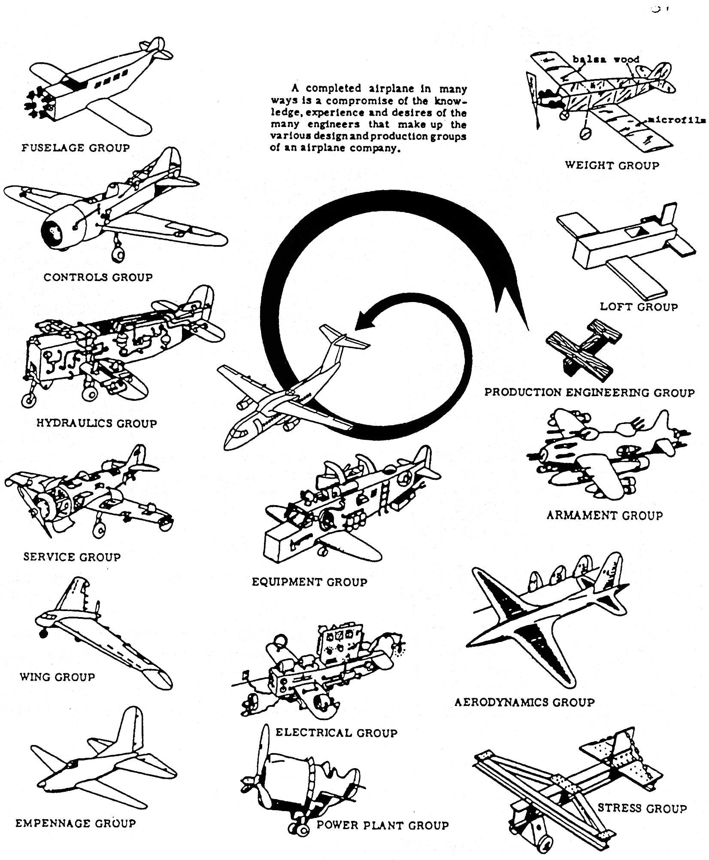
Lecture Contents
Preliminary Aircraft Sizing
6.1. Introduction
6.2. Payload-Range Diagram
6.3. Rapid Sizing Method for Aircraft Weight
6.3.1 Empty Weight Estimation
6.3.2 Fuel Weight Estimation
6.3.3 Example Calculations (business jet & prop)
6.4. T/W – W/S and W/P – W/S Diagrams
6.4.1 Sizing for Stall Speed
6.4.2 Sizing for Take-off Distance
6.4.3 Sizing for Landing Distance
6.4.4 Drag Polar & Climb Behavior Requirements
6.4.5 Maneuvering Behavior Requirements
6.4.6 Design Point & Sanity Checks
Notes:
Contents from this slide deck is sourced and adapted from Aircraft Design 1 Course content by Dr. Joris Melkert from Delft, University of Technology

Slide 4
6.4 T/W – W/S and W/P – W/S Diagrams
Now that we have the preliminary aircraft weight, we want to find estimates for:
The wing area, S
The take-off thrust (T_{TO} ) or power (P_{TO})
Maximum lift coefficient (clean, take-off, landing), C_{Lmax}
Drag polar
To do this, we use:
For jet aircraft: a T/W-W/S diagram
For propeller aircraft: a W/P-W/S diagram
T/W = thrust loading
W/P = power loading
W/S = Wing Loading

Slide 5
6.4 T/W – W/S and W/P – W/S Diagrams
This diagram can be used to further size your aircraft:
Choose the highest possible wing loading (W/S)
Choose the lowest possible thrust or power loading (T/W or W/P)
For jet aircraft:
For propeller aircraft:
Thrust Loading T/W
Power Loading W/P
Wing Loading W/S
Wing Loading W/S

Slide 6
6.4 T/W – W/S and W/P – W/S Diagrams
These diagrams contain information that accounts for the following requirements:
Stall speed
Take-off distance
Landing distance
Climb speed & rate behavior
Maneuvering behavior
Cruise speed
For jet aircraft:
For propeller aircraft:
4
2
T/W
W/P
1
4
5
4
2
1
3
3
W/S
W/S

Slide 7
6.4.1 Sizing for Stall Speed
Sizing for stall speed is done using the lift equation:
Choosing V_{s} for a given value of C_{Lmax} leads to an expression for W/S:
Rearrange to Vs
X

Slide 8
6.4.1 Sizing for Stall Speed
Remember that increasing the value for C_{Lmax} leads to more complex flap and slat systems that:
Weigh more
Cost more
Are more sensitive to failure
Require more maintenance
Typical values for C_{Lmax} can be used in this stage of the design:
 | C_{Lmax} clean |  | C_{Lmax} take-off |  | C_{Lmax} land
Aircraft type | min | max | min | max | min | max
Homebuilt aircraft | 1.2 | 1.8 | 1.2 | 1.8 | 1.2 | 2.0
Single engine piston props | 1.3 | 1.9 | 1.3 | 1.9 | 1.6 | 2.3
Twin engine props | 1.2 | 1.8 | 1.4 | 2.0 | 1.6 | 2.5
Agricultural | 1.3 | 1.9 | 1.3 | 1.9 | 1.3 | 1.9
Business jets | 1.4 | 1.8 | 1.6 | 2.2 | 1.6 | 2.6
Regional turboprops | 1.5 | 1.9 | 1.7 | 2.1 | 1.9 | 3.3
Transport jets | 1.2 | 1.8 | 1.6 | 2.2 | 1.8 | 2.8
Military trainers | 1.2 | 1.8 | 1.4 | 2.0 | 1.6 | 2.2
Fighters | 1.2 | 1.8 | 1.4 | 2.0 | 1.6 | 2.6
Military patrol, bombers and transport | 1.2 | 1.8 | 1.6 | 2.2 | 1.8 | 3.0
Flying boats, amphibians and float planes | 1.2 | 1.8 | 1.6 | 2.2 | 1.8 | 3.4
Supersonic aircraft | 1.2 | 1.8 | 1.6 | 2.0 | 1.8 | 2.2

Slide 9
6.4.1 Sizing for Stall Speed (Example Single engine propeller)
Example: Single engine propeller aircraft
V_{S} in landing configuration must not be higher than 61 kts
V_{S} < 61 kts = 31.4 m/s
Assume a flap design with an average complexity
C_{Lmax} = 1.8
Results in a wing loading that must be less than
W/S < 1086 N/m²
Note that W/S is no function of W/P
Design Region

Slide 10
6.4.1 Sizing for Stall Speed (Example Business Jet)
Example: Business jet aircraft
Marketing requirements tell us:
V_{S} in landing configuration must not be higher than 85 kts
V_{S} in clean configuration must not be higher than 100 kts
Assume a flap design with an average complexity
C_{Lmax, clean} = 1.8
C_{Lmax, landing} = 2.6
Results in a wing loading that must be less than
(W/S)_{clean} < 2917 N/m² = Design Critical!
(W/S)_{landing} < 3044 N/m²
Note that again, W/S is no function of T/W
Design Region

Slide 11
Lecture Contents
Preliminary Aircraft Sizing
6.1. Introduction
6.2. Payload-Range Diagram
6.3. Rapid Sizing Method for Aircraft Weight
6.3.1 Empty Weight Estimation
6.3.2 Fuel Weight Estimation
6.3.3 Example Calculations (business jet & prop)
6.4. T/W – W/S and W/P – W/S Diagrams
6.4.1 Sizing for Stall Speed
6.4.2 Sizing for Take-off Distance
6.4.3 Sizing for Landing Distance
6.4.4 Drag Polar & Climb Behavior Requirements
6.4.5 Maneuvering Behavior Requirements
6.4.6 Design Point & Sanity Checks
Notes:
Contents from this slide deck is sourced and adapted from Aircraft Design 1 Course content by Dr. Joris Melkert from Delft, University of Technology

Slide 12
6.4.2 Sizing for Take-off Requirements
Influencing Factors driving take-off requirements
W_{TO}
Take-off speed
(T/W)_{TO} or (W/P)_{TO}
Aerodynamic drag
Ground friction
Pilot technique
(Airworthiness) requirements
In this stage of the design, we cannot perform any detailed calculation yet so we must rely on statistics
35 or
50 ft
Ground roll
Air distance
Take-off distance, s_{TO}

Slide 13
6.4.2 Sizing for Take-off Requirements
Statistics has shown that there are several influencing factors:
W/S
W/P or T/W
C_{Lmax}
Density ratio, σ = ρ / ρ₀
These are combined in the Take-off Parameter (TOP).
TOP_{prop} and TOP_{jet} have different units!
For propeller aircraft:
For jet aircraft:

Slide 14
6.4.2 Sizing for Take-off Requirements
Use statistics to determine the relationship between field length and the TOP
To determine the TOP for reference aircraft, you must determine:
W/S
W/P or T/W
C_{Lmax}
Density ratio, σ = ρ / ρ₀
determined from aircraft data
determined from aircraft & engine data
Not normally provided, assume average value for analyses
Taken from performance data, normally σ = 1 (sea level take-off)

Slide 15
6.4.2 Sizing for Take-off Requirements (Example Prop. A/C)
From the reference aircraft, the TOP vs. S_{TO} graph can be constructed
A trendline is plotted through the reference data
This leads to the following equation:
s_{TO}= 0.0577 * TOP²_{prop} + 8.6726 * TOP_{prop}
The take-off length s_{TO} for a new A/C is s_{TO} = 700 m
Solving for TOP_{prop} leads to:
TOP₁ = 58.18
TOP₂ = -208.49
Now check the graph to select the correct value!
Notes:
s_{TO = take-off length}

Slide 16
6.4.2 Sizing for Take-off Requirements (Example Prop. A/C)
We have identified TOP = 58.18
We are now looking for an expression of T/W as a function of W/S
Rearranging gives:
Now we can fill in the TOP, make some assumptions for C_{LMax} based on the aircraft (Prop A/C C_{LMax} ranges from 1.3-1.9) and assume take-off requirement given is at sea-level (σ = 1)
Y
1/X

Slide 17
6.4.2 Sizing for Take-off Requirements (Example Prop. A/C)
Design Region
Notes:
IMPORTANT NOTE: The L should be capitalized in CLMAX as this is for the whole aircraft, not the airfoil

Slide 18
6.4.2 Sizing for Take-off Requirements (Example Prop. A/C)
Design Region
Notes:
IMPORTANT NOTE: The L should be capitalized in CLMAX as this is for the whole aircraft, not the airfoil

Slide 19

6.4.2 Sizing for Take-off Requirements (Example Business Jet)
Similarly to Propeller Aircraft, the following graphs may be constructed for a Bus. Jet
Notes:
Sometimes a linear curve does not fit your data well. Use curve-fitting tools to your advantage!
Remember to update the trend equations as you add or change reference aircraft!

Slide 20
6.4.2 Sizing for Take-off Requirements (Example Business Jet)
From the reference aircraft, the TOP vs. S_{TO} graph can be constructed
A trendline is plotted through the reference data
This leads to the following equation:
1500 = -2x10⁻⁵ x TOP²_{jet} + 0.3623 x TOP_{jet}
If the design take-off length is s_{TO} = 1500 m
Solving for TOP_{jet} leads to:
TOP₁ = 6404
TOP₂ = 11710
Now check the graph to select the correct value!

Slide 21
6.4.2 Sizing for Take-off Requirements (Example Business Jet)
We have identified TOP = 6404
We are now looking for an expression of T/W as a function of W/S
Rearranging gives:
Now we can fill in the TOP, make some assumptions for C_{LMax} based on the aircraft (Business jet C_{LMax} ranges from 1.6-2.2) and assume take-off requirement given is at sea-level (σ = 1)
Y
X

Slide 22
6.4.2 Sizing for Take-off Requirements (Example Business Jet)
Design Region

Slide 23
6.4.2 Sizing for Take-off Requirements (Example Business Jet)
Design Region

Slide 24
Lecture Contents
Preliminary Aircraft Sizing
6.1. Introduction
6.2. Payload-Range Diagram
6.3. Rapid Sizing Method for Aircraft Weight
6.3.1 Empty Weight Estimation
6.3.2 Fuel Weight Estimation
6.3.3 Example Calculations (business jet & prop)
6.4. T/W – W/S and W/P – W/S Diagrams
6.4.1 Sizing for Stall Speed
6.4.2 Sizing for Take-off Distance
6.4.3 Sizing for Landing Distance
6.4.4 Drag Polar & Climb Behavior Requirements
6.4.5 Maneuvering Behavior Requirements
6.4.6 Design Point & Sanity Checks
Notes:
Contents from this slide deck is sourced and adapted from Aircraft Design 1 Course content by Dr. Joris Melkert from Delft, University of Technology

Slide 25
6.4.3 Sizing for Landing Requirements
Influencing factors driving landing requirements
Deceleration method used (brakes, speed brakes, thrust reversers)
Flying qualities of the airplane (high wing, low wing)
Landing weight W_{L}
Approach speed V_{A}
Pilot technique
Airworthiness/Design requirements
In this stage of the design, we cannot perform any detailed calculation yet, so we again rely on statistics
50 ft
Air distance
Ground roll
Landing distance, s_{L}

Slide 26
6.4.3 Sizing for Landing Requirements
Typical values for W_{L}/W_{TO} can be used in this stage of the design to estimate landing weight:
 | W_{L}/W_{TO}
Aircraft type | minimum | average | maximum
Homebuilt aircraft | 0.96 | 1.00 | 1.00
Single engine piston props | 0.95 | 0.997 | 1.00
Twin engine props | 0.88 | 0.99 | 1.00
Agricultural | 0.70 | 0.94 | 1.00
Business jets | 0.69 | 0.88 | 0.96
Regional turboprops | 0.92 | 0.98 | 1.00
Transport jets | 0.65 | 0.84 | 1.00
Military trainers | 0.87 | 0.99 | 1.10
Fighters (jets) | 0.78 | - | 1.00
(turboprops) | 0.57 | - | 1.00
military patrol, bombers and transport (jets) | 0.68 | 0.76 | 0.83
(tbp’s) | 0.77 | 0.84 | 1.00
flying boats, amphibians and float planes (land) | 0.79 | - | 0.95
(sea) | 0.98 | - | 1.00
Supersonic aircraft | 0.63 | 0.75 | 0.88

Slide 27
6.4.3 Sizing for Landing Requirements
During landing the main task is to safely reduce the speed to zero (total aircraft kinetic energy to zero)
The deceleration used will not vary much since passengers, crew and equipment can only withstand a certain deceleration
The time it takes to slow down, and the total distance needed for this are therefore directly coupled to the approach speed of the aircraft squared, V_{A}²
Certification requirements do not allow the effect of thrust reversers be taken into account.
No effect of thrust or power loading on the landing distance!
In certification requirements the approach speed is limited by the stall speed in landing configuration:

Slide 28
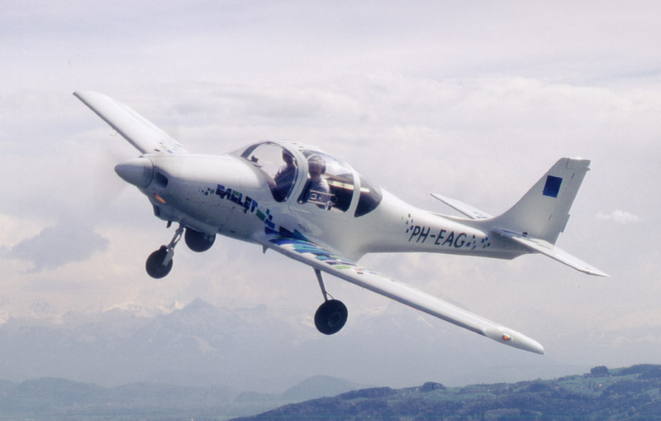
6.4.3 Sizing for Landing Requirements
Real-world examples take-off and landing distance experiments:
Resulting from the Eaglet test flight campaign
Notes:
The Take-off distance is can clearly be correlated to the aircraft configuration (and therefore take-off may be statistically related to aircraft performance through the TOP)
The Landing distance is can not directly be correlated to the aircraft configuration (and therefore there are other factors at play: pilot skill, weather, …, so we may need to find a different way to estimate it, and a Landing Parameter is not appropriate)

Slide 29
6.4.3 Sizing for Landing Requirements
Purely based on statistics the following relationship has been found between landing distance and the stall speed in landing configuration for CS/JAR/FAR 23 aircraft:
But, there is some variation in these landing/take-off lengths (which also varies per configuration):
Take-off:
Clean configuration 17 %
Intermediate flaps 21 %
Landing:
Clean configuration 30 %
Intermediate flaps 43 %
Full flaps 26 %

Slide 30
6.4.3 Sizing for Landing Requirements
Assume equilibrium between lift and weight at the approach speed to be able to determine V_{S,land}
And
Then:

Slide 31
6.4.3 Sizing for Landing Requirements (Example Prop. A/C)
For example: mission requirements state that s_{land} ≤ 550 m
The stall speed in landing configuration must be chosen such that it meets the airworthiness requirements:
Now choose a range of C_{Lmax} and solve the equation see the effect on (W/S)_{TO}
Assume W_{L}/W_{TO} = 0.95 => f = 0.95 (look at your mission/fuel weights!)
Assume C_{Lmax} = 1.6 – 2.2 (look at your aircraft-specific numbers!)
Plot the resulting vertical lines on the diagram!
Rearrange

Slide 32
6.4.3 Sizing for Landing Requirements (Example Prop. A/C)
Design Region

Slide 33
6.4.3 Sizing for Landing Requirements (Example Prop. A/C)
Design Region
Notes:
IMPORTANT NOTE: The L should be capitalized in CLMAX as this is for the whole aircraft, not the airfoil

Slide 34
6.4.3 Sizing for Landing Requirements (Example Jet A/C)
For example: mission requirements state that s_{land} ≤ 1200 m
The stall speed in landing configuration must be chosen such that it meets the airworthiness requirements:
Now choose a range of C_{Lmax} and solve the equation see the effect on (W/S)_{TO}
Assume W_{L}/W_{TO} = 0.88 => f = 0.88 (look at your mission/fuel weights!)
Assume C_{Lmax} = 1.6 – 2.4 (look at your aircraft-specific numbers!)
Plot the resulting vertical lines on the diagram!
Rearrange
Notes:
Note: You can compare this value with other aircraft and with the airworthiness requirements

Slide 35
6.4.3 Sizing for Landing Requirements (Example Jet A/C)
Design Region

Slide 36
6.4.3 Sizing for Landing Requirements (Example Jet A/C)
Design Region

Slide 37
Lecture Contents
Preliminary Aircraft Sizing
6.1. Introduction
6.2. Payload-Range Diagram
6.3. Rapid Sizing Method for Aircraft Weight
6.3.1 Empty Weight Estimation
6.3.2 Fuel Weight Estimation
6.3.3 Example Calculations (business jet & prop)
6.4. T/W – W/S and W/P – W/S Diagrams
6.4.1 Sizing for Stall Speed
6.4.2 Sizing for Take-off Distance
6.4.3 Sizing for Landing Distance
6.4.4 Drag Polar & Climb Behavior Requirements
6.4.5 Maneuvering Behavior Requirements
6.4.6 Design Point & Sanity Checks
Notes:
We’ve found the drag components and CD0

Slide 38
6.4.4 Drag Polar & Climb Behavior Requirements
The climb behavior additions to the T/W-W/S and W/P-W/S diagrams will be discussed in the following subsections:
Drag polar and zero-lift drag
Climb Rate for Propeller Aircraft (+ example)
Climb Gradient for Propeller aircraft (+ example)
Climb Rate for Jet Aircraft (+ example)
Climb Gradient for Jet aircraft (+ example)

Slide 39
6.4.4 Drag Polar & Climb Behavior Requirements
The climb behavior additions to the T/W-W/S and W/P-W/S diagrams will be discussed in the following subsections:
Drag polar and zero-lift drag
Climb Rate for Propeller Aircraft (+ example)
Climb Gradient for Propeller aircraft (+ example)
Climb Rate for Jet Aircraft (+ example)
Climb Gradient for Jet aircraft (+ example)

Slide 40
6.4.4 Drag Polar & Climb Behavior Requirements 1 – Drag polar and zero-lift drag
For the evaluation of climb requirements, the drag polar (C_{L}/C_{D} Graph) should be known
Definitions of Drag:
Total drag
Pressure drag
Friction drag
wetted area
span loading
Induced drag
Profile drag
volume and shape
Form drag
vortices
due to lift
waves
due to lift
waves due
to volume
boundary layer
flow separation
Vortex drag
Wave drag
Wake drag
Total drag

Slide 41
6.4.4 Drag Polar & Climb Behavior Requirements 1 – Drag polar and zero-lift drag
For the evaluation of climb requirements, the drag polar (C_{L}/C_{D} Graph) should be known
Assume that the drag polar takes the following shape:
Where f = equivalent parasite drag area (can be related to wetted area S_{wet} of the aircraft) A = wing aspect ratio e = planform/Oswald efficiency factor (= 1 for elliptical circulation distribution, and usually tabulated for other distributions)
S = the wing trapezoidal area (at this point unknown, so use a reference aircraft’s* wing area!)
with
Notes:
*Or an average of multiple reference aircraft.
It’s ok to “cherry-pick” data at this point (though always do this conscientiously), as this may help “steer” the design towards feasible solutions. Note that the final design will be influenced by many variables based on external references (at first) and (later-on) internal design iterations. Be careful referencing “concepts” rather than physical aircraft, as reference concepts may not actually be feasible!

Slide 42
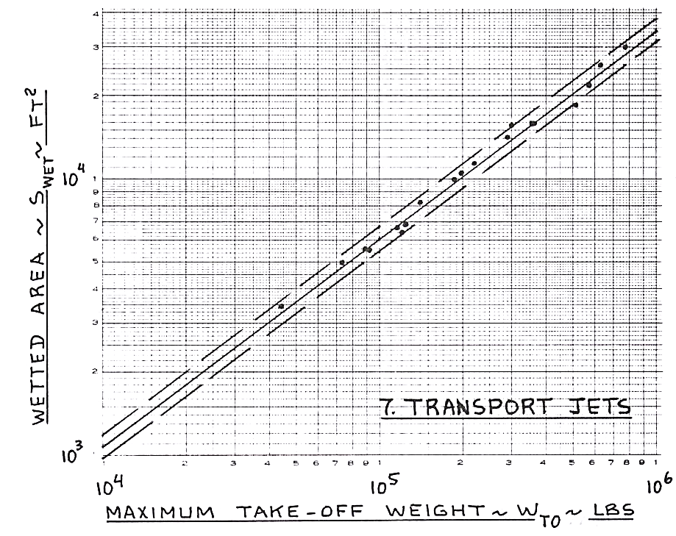
6.4.4 Drag Polar & Climb Behavior Requirements 1 – Drag polar and zero-lift drag
Wetted area S_{wet} as a function of MTOW, W_{TO}
Note values are in ft² and lbs (1 lb = 0.4538 kg)
Logarithmic scaled axes
Spread here is within ±10% of average
The following equation can be used to determine the relation between S_{wet} and W_{TO}
Wetted Area, S_{wet} [ft² ]
MTOW, W_{TO}[lbs]
Notes:
Source: Roskam
1 lb = 0.4538 kg

Slide 43
6.4.4 Drag Polar & Climb Behavior Requirements 1 – Drag polar and zero-lift drag
The following constants for c and d can be used:
Aircraft type | c | d
Homebuilt aircraft | 1.2362 | 0.4319
Single engine piston props | 1.0892 | 0.5147
Twin engine props | 0.8635 | 0.5632
Agricultural | 1.0447 | 0.5326
Business jets | 0.2263 | 0.6977
Regional turboprops | -0.0866 | 0.8099
Transport jets | 0.0199 | 0.7531
Military trainers | 0.8565 | 0.5423
Fighters | -0.1289 | 0.7506
military patrol, bombers and transport | 0.1628 | 0.7316
flying boats, amphibians and float planes | 0.6295 | 0.6708
Supersonic aircraft | -1.1868 | 0.9609
Wetted Area, S_{wet} [ft² ]
MTOW, W_{TO}[lbs]
Notes:
Source: Roskam
1 lb = 0.4538 kg

Slide 44
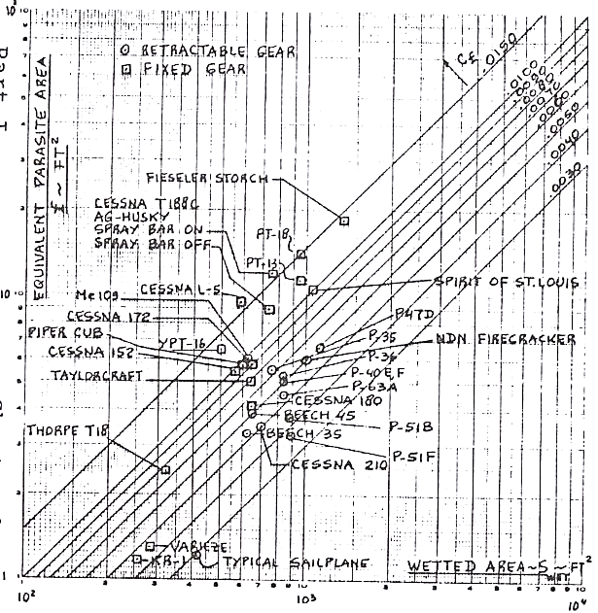
6.4.4 Drag Polar & Climb Behavior Requirements 1 – Drag polar and zero-lift drag
Equivalent parasite area f as a function of wetted area S_{wet} for single engine propeller driven aircraft
Note values are in ft² (1 ft² = 0.0929 m²)
Logarithmic scaled axes
Note trend lines based on smoothness (c_{f})
Parasite area f [ft² ]
Wetted area S_{wet}[ft² ]
Notes:
Source: Roskam
the effect of the smoothness and streamlining of the aircraft is expressed as the friction coefficient c_{f}

Slide 45
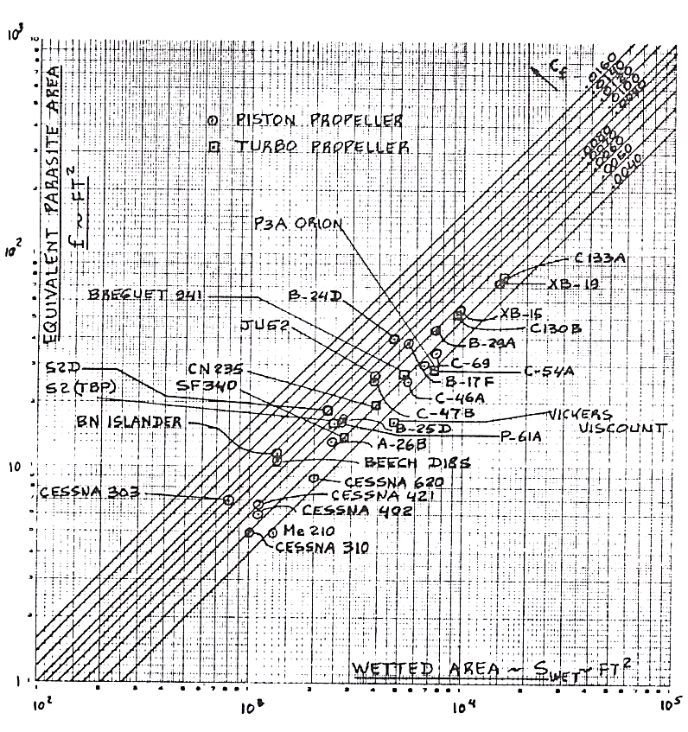
6.4.4 Drag Polar & Climb Behavior Requirements 1 – Drag polar and zero-lift drag
Equivalent parasite area f as a function of wetted area S_{wet} for twin engine propeller driven aircraft
Note values are in ft²
Logarithmic scaled axes
Note trend lines based on smoothness (c_{f})
Parasite area f [ft² ]
Wetted area S_{wet}[ft² ]
Notes:
Source: Roskam
the effect of the smoothness and streamlining of the aircraft is expressed as the friction coefficient c_{f}

Slide 46
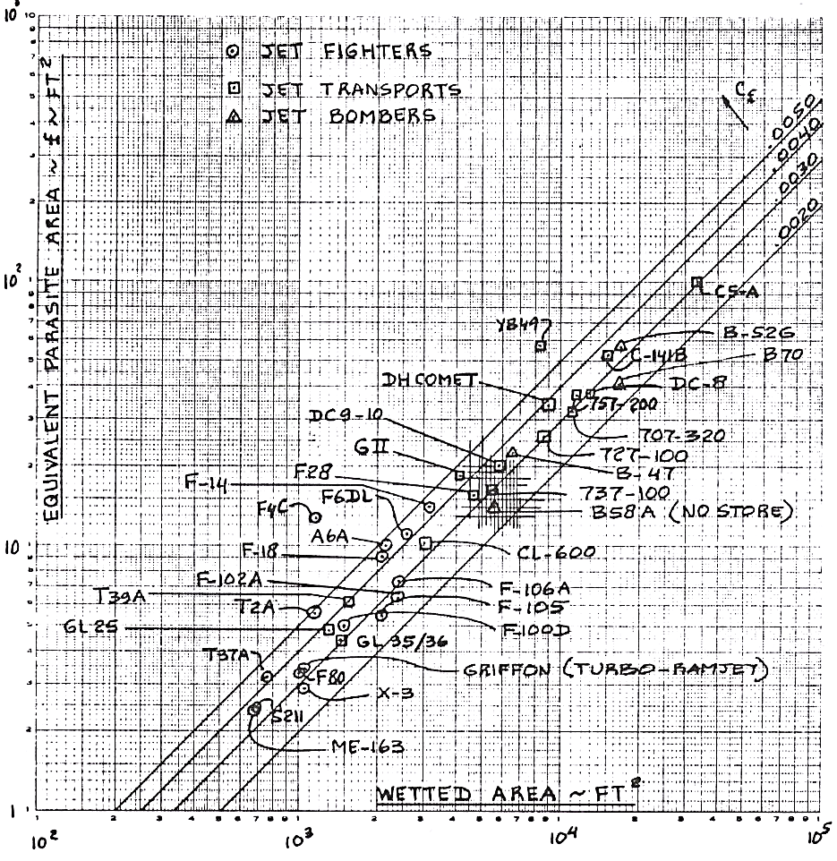
6.4.4 Drag Polar & Climb Behavior Requirements 1 – Drag polar and zero-lift drag
Equivalent parasite area f as a function of wetted area S_{wet} for jet driven aircraft
Note values are in ft²
Logarithmic scaled axes
Note trend lines based on smoothness (c_{f})
Parasite area f [ft² ]
Wetted area S_{wet}[ft² ]
Notes:
Source: Roskam
the effect of the smoothness and streamlining of the aircraft is expressed as the friction coefficient c_{f}

Slide 47
6.4.4 Drag Polar & Climb Behavior Requirements 1 – Drag polar and zero-lift drag
On the log-scale one can find expressions for the parasite drag area as a function of the wetted area
The following expression can be used (Note that S_{wet} and f are given in ft²):
The values in the table on the right can be used for a and b
Depending on expected smoothness/streamlining value c_{f}
c_{f} | a | b
0.0090 | -2.0458 | 1.0
0.0080 | -2.0969 | 1.0
0.0070 | -2.1549 | 1.0
0.0060 | -2.2218 | 1.0
0.0050 | -2.3010 | 1.0
0.0040 | -2.3979 | 1.0
0.0030 | -2.5229 | 1.0
0.0020 | -2.6990 | 1.0
For assignment 2, to determine clean C_{D0}:
Determine take-off mass W_{TO} in lbs
Determine values for c and d based on aircraft type
Determine wetted area S_{wet} in ft²
Make an estimate of c_{f} for your aircraft for a and b values
Find the equivalent drag area f in ft² and then convert results back to m²
Notes:
Source: Roskam

Slide 48
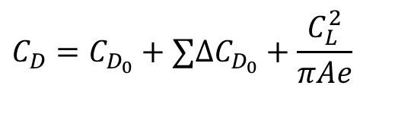
6.4.4 Drag Polar & Climb Behavior Requirements 1 – Drag polar and zero-lift drag
There will be an additional effect on C_{D0} due to the extension of the flaps and the undercarriage
Use the following numbers:
For the CL-dependent aspect of the drag polar, we are still missing:
The aspect ratio A (at this point, A is still a variable)
Oswald span efficiency factor e
 | ΔC_{Do}
Clean | 0
Take-off Flaps | 0.010 - 0.020
Landing Flaps | 0.055 - 0.075
Landing Gear | 0.015 - 0.025
For assignment 2, to determine “dirty” C_{D0}:
Use clean C_{D0}
Add ΔC_{Do} Values depending on configurations
$$C_{D}=C_{D_{0}}+∑{ΔC}_{D_{0}}+\frac{C_{L}^{2}}{πAe}$$
Or
Notes:
Source: Roskam

Slide 49
6.4.4 Drag Polar & Climb Behavior Requirements 1 – Drag polar and zero-lift drag
The Oswald span efficiency factor e indicates the deviation from the “ideal wing” being the wing with a straight quarter chord line, an elliptical chord distribution and an elliptical lift distribution:
The Oswald span efficiency factor decreases below 1 when the “ideal wing” conditions are not met
Lift distribution (e=1)
Chord distribution
Notes:
Source: Roskam

Slide 50

6.4.4 Drag Polar & Climb Behavior Requirements 1 – Drag polar and zero-lift drag
Typical values for C_{Do} and e:
Extension of flaps and undercarriage also has an effect on e:
For a typical jet aircraft:
Aircraft type | C_{Do} | e
Small single engine aircraft
- fixed gear | 0.025 – 0.040 | 0.65 – 0.75
- retractable gear | 0.020 – 0.030 | 0.75 – 0.85
Agricultural aircraft
- spray system removed | 0.060 | 0.65 – 0.75
- spray system installed | 0.070 – 0.080 | 0.65 – 0.75
Twin piston aircraft | 0.022 – 0.028 | 0.75 – 0.85
Turbopropeller aircraft | 0.018 – 0.024 | 0.80 – 0.85
High-subsonic jet aircraft | 0.014 – 0.020 | 0.75 – 0.85*
Use this table as sanity check for C_{D0}
* The higher the sweep angle the lower e
Configuration | e
Clean | 0.80 – 0.85
Take-off Flaps | 0.75 – 0.80
Landing Flaps | 0.70 – 0.75
Undercarriage | No effect
Notes:
If your aircraft type isn’t listed, use the data in the table to estimate a value for e
For the assignments, you can also use this table for other aircraft types

Slide 51
6.4.4 Drag Polar & Climb Behavior Requirements 1 – Drag polar and zero-lift drag (Examples)
Single engine propeller driven aircraft:
W_{TO} = 1,899 lbs
c_{f} = 0.0060
a = -2.2218 b = 1.0000
c = 1.0892 d = 0.5147
S_{wet} = 598 ft²
f = 0.333 m²
W/S = 850 N/m²
C_{Do} = 0.0335
Business jet aircraft:
W_{TO} = 56,890 lbs
c_{f} = 0.0030
a = -2.5229 b = 1.0000
c = 0.2263 d = 0.6977
S_{wet} = 3,499 ft²
f = 0.975 m²
W/S = 3,500 N/m²
C_{Do} = 0.0145
Results from both cases satisfy the sanity check

Slide 52
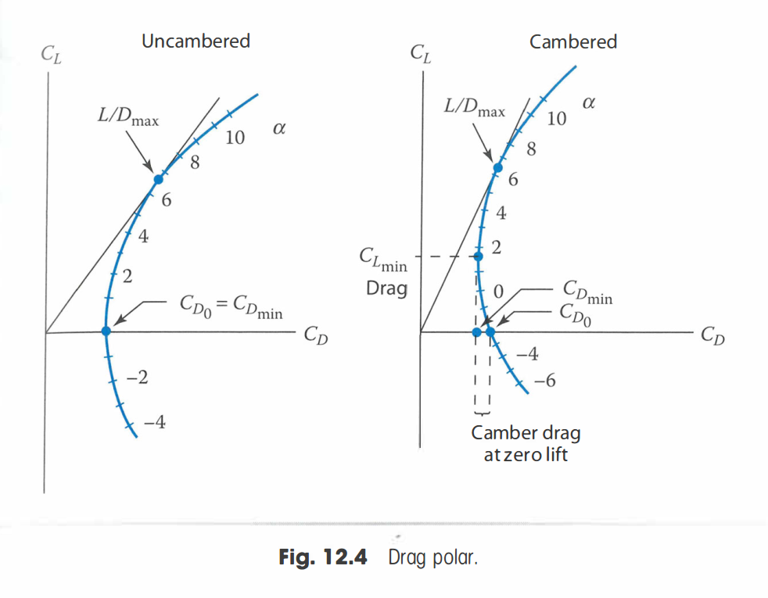
6.4.4 Drag Polar & Climb Behavior Requirements 1 – Drag polar and zero-lift drag
Recall: to minimize L/D, find the tangent of the drag polar through the origin.
Single engine propeller driven aircraft:
W_{TO} = 1,899 lbs
c_{f} = 0.0060
a = -2.2218 b = 1.0000
c = 1.0892 d = 0.5147
S_{wet} = 598 ft²
f = 0.333 m²
W/S = 850 N/m²
C_{Do} = 0.0335
with

Slide 53
6.4.4 Drag Polar & Climb Behavior Requirements
The climb behavior additions to the T/W-W/S and W/P-W/S diagrams will be discussed in the following subsections:
Drag polar and zero-lift drag
Climb Rate for Propeller Aircraft (+ example)
Climb Gradient for Propeller aircraft (+ example)
Climb Rate for Jet Aircraft (+ example)
Climb Gradient for Jet aircraft (+ example)
= climb speed ≠ c
Airspeed V
Climb rate c
Climb angle γ

Slide 54
6.4.4 Drag Polar & Climb Behavior Requirements 2 – Climb Rate Requirements
Climb requirements are normally dominated by the certification requirements
Typical requirements relate to:
Climb out after take-off
All engines operating climb (AEO)
One engine inoperative climb (OEI)
Balked landing (rejected landing)
Climb requirements can be given in terms of
Climb rate, c (m/s)
Climb gradient, c/V (%)
= climb speed ≠ c
Airspeed V
Climb rate c
Climb angle γ
Notes:
Climb rate is not climb gradient. Climb gradient is a speed / a speed and thus unitless.

Slide 55
6.4.4 Drag Polar & Climb Behavior Requirements 2 – Climb Rate Requirements
Climb requirements in the airworthiness regulations
First define the conditions under which the climb requirement must be met. E.g.:
Power setting
Landing gear setting
Flap setting
These settings determine the drag polar we need to use
Then the climb requirement itself is discussed
Notes:
For instance, clear an x meter obstacle on take off after x meters
One engine climb rate.

Slide 56
6.4.4 Drag Polar & Climb Behavior Requirements 2 – Climb Rate Requirements
Climb requirements airworthiness regulations:
Small aircraft:
CS/JAR/FAR 23.65 Climb: all engines operating
CS/JAR/FAR 23.66 Take-off climb: one-engine-inoperative
CS/JAR/FAR 23.67 Climb: one-engine inoperative
CS/JAR/FAR 23.69 En-route climb/descent
CS/JAR/FAR 23.77 Balked landing
Large aircraft:
CS/JAR/FAR 25.111 Take-off path
CS/JAR/FAR 25.115 Take-off flight path
CS/JAR/FAR 25.117 Climb: general
CS/JAR/FAR 25.119 Landing climb: all engines operating
CS/JAR/FAR 25.121 Climb: one-engine inoperative
Example regulation conditions:
Not more than maximum continuous power on each engine
The landing gear retracted
The wing flaps in the take-off position(s)
A climb speed not less than
the greater of 1.1 V_{MC} or 1.2 V_{S1} for twin-engine A/C
1.2 V_{S1} for single engine A/C
Example regulation Requirement:
When the maximum mass is 2721 kg or less: Steady gradient of climb at sea level of at least
8.3 % for landplanes
6.7 % for seaplanes
Notes:
The CS/JAR/FAR regulations were recently updated (around the 2016 timeframe), and these numbers may be deprecated. These regulations still exist, but may no longer have this numbering.
We don’t know engines yet, so we leave that for now.
Vmc = Minimum control speed
Vs1 = stall speed
Check which are critical and assure you can meet the requirement in the conditions
How do we do that?

Slide 57
6.4.4 Drag Polar & Climb Behavior Requirements 2 – Climb Rate Requirements
To determine how climb requirements translate to the diagram:
By definition:
From performance theory, we know:
Therefore:
= climb speed ≠ c
Airspeed V
Climb rate c
Climb angle γ
Remember:
c = Climb rate
P_{a} = Available power
P_{r} = Required Power
W = Aircraft weight

Slide 58
6.4.4 Drag Polar & Climb Behavior Requirements 2 – Climb Rate Requirements (Propeller Aircraft)
Remember:
P_{br} = Brake/shaft Power
Ƞ_{p} = Propulsive efficiency
For propeller aircraft we know:
Assuming small climb angles and steady climb:
Then:
1
and
2
3
or
4
2
4
1
and
3
Notes:
Note we don’t have a velocity, or a Cd but we know our S and rho

Slide 59
6.4.4 Drag Polar & Climb Behavior Requirements 2 – Climb Rate Requirements (Propeller Aircraft)
To maximize the climb rate c, we must maximize:
Which means we must maximize:
Assuming
, then using
, we get
Notes:
Prop eff doesn’t change. Etc. etc.
We can only change Cl and Cd
Using the relation that relates the drag coefficient to the Cd0 and the CL. We can find CL in terms of knowns.

Slide 60
6.4.4 Drag Polar & Climb Behavior Requirements 2 – Climb Rate Requirements (Propeller Aircraft)
Now, using
and
, we get
X
1/y
Substitute
Rearrange for y
y
X
Notes:
Remember we’re working towards W/P as a function of W/S

Slide 61
6.4.4 Drag Polar & Climb Behavior Requirements 2 – Climb Rate Requirements (Propeller Aircraft)
We can now add climb performance in the W/P – W/S diagram using:
Example calculation:
y
X
c = 5 m/s at sea level
e = 0.70
C_{Do} = 0.0335
η_{p} = 0.80
Power is take-off power => P_{br} = P_{TO}
A is still to be determined, so we can use several values to test the performance
Notes:
A is the aspect ratio, use a range. (based off reference aircraft)

Slide 62
6.4.4 Drag Polar & Climb Behavior Requirements 2 – Climb Rate Requirements (Propeller Aircraft)
Design Region
Notes:
Should we be below or above this line?
Condition and variables at sea level takeoff

Slide 63
6.4.4 Drag Polar & Climb Behavior Requirements 2 – Climb Rate Requirements (Propeller Aircraft)
Design Region
Notes:
IMPORTANT NOTE: The L should be capitalized in CLMAX as this is for the whole aircraft, not the airfoil

Slide 64
6.4.4 Drag Polar & Climb Behavior Requirements 3 – Climb Gradient Requirements (Propeller Aircraft)
Besides climb speed, requirements also indicate climb rates (c/V)
Similarly to before:
Maximizing for c/V leads to a value for C_{L} which is very close to the maximum lift coefficient. This would result in a dangerous flight condition. It is best to use a safe margin of 0.2 on the C_{Lmax} and then construct lines for W/P versus W/S
Using
Notes:
In this way, CLmax in the equation becomes (CLMax-0.2)

Slide 65
6.4.4 Drag Polar & Climb Behavior Requirements 3 – Climb Gradient Requirements (Propeller Aircraft)
As before, all values are known except P/W, W/S:
Remember, we assumed:
1/y
y
Rearranging for y
X
X
Substitute CL & CD
and

Slide 66
6.4.4 Drag Polar & Climb Behavior Requirements 3 – Climb Gradient Requirements (Propeller Aircraft)
Example single engine driven propeller aircraft:
c/V = 0.083 at sea level
e = 0.70
C_{Do} = 0.0335
η_{p} = 0.80
Power is take-off power => P_{br} = P_{TO}
A is still to be determined
C_{Lmax} = 1.8 => C_{L} = 1.6
y
X

Slide 67
6.4.4 Drag Polar & Climb Behavior Requirements 3 – Climb Gradient Requirements (Propeller Aircraft)
Design Region

Slide 68
6.4.4 Drag Polar & Climb Behavior Requirements 3 – Climb Gradient Requirements (Propeller Aircraft)
Design Region
Notes:
IMPORTANT NOTE: The L should be capitalized in CLMAX as this is for the whole aircraft, not the airfoil

Slide 69
6.4.4 Drag Polar & Climb Behavior Requirements
The climb behavior additions to the T/W-W/S and W/P-W/S diagrams will be discussed in the following subsections:
Drag polar and zero-lift drag
Climb Rate for Propeller Aircraft (+ example)
Climb Gradient for Propeller aircraft (+ example)
Climb Rate for Jet Aircraft (+ example)
Climb Gradient for Jet aircraft (+ example)
= climb speed ≠ c
Airspeed V
Climb rate c
Climb angle γ

Slide 70
6.4.4 Drag Polar & Climb Behavior Requirements 4 – Climb Rate Requirements (Jet Aircraft)
Similarly, to the propeller aircraft:
By definition:
From performance theory, we know:
Therefore:
= climb speed ≠ c
Airspeed V
Climb rate c
Climb angle γ
Remember:
c = Climb rate
P_{a} = Available power
P_{r} = Required Power
W = Aircraft weight

Slide 71
6.4.4 Drag Polar & Climb Behavior Requirements 4 – Climb Rate Requirements (Jet Aircraft)
For jet aircraft:
Assuming again small climb angles and steady climb:
Then:
and
or

Slide 72
6.4.4 Drag Polar & Climb Behavior Requirements 4 – Climb Rate Requirements (Jet Aircraft)
To maximized the climb rate c, we have to maximize:
Assuming
From which we find:
, then using
, we get
Notes:
CL / CD

Slide 73
6.4.4 Drag Polar & Climb Behavior Requirements 4 – Climb Rate Requirements (Jet Aircraft)
y
X
y
Now, using
Rearrange for y
X
y
Substitute
X

Slide 74
6.4.4 Drag Polar & Climb Behavior Requirements 4 – Climb Rate Requirements (Jet Aircraft)
We can now add climb performance in the T/W–W/S diagram using:
Example calculation:
y
X
c = 20 m/s at sea level
e = 0.85
C_{Do} = 0.0145
A is still to be determined, so we can use several values to test the performance

Slide 75
6.4.4 Drag Polar & Climb Behavior Requirements 4 – Climb Rate Requirements (Jet Aircraft)
Design Region

Slide 76
6.4.4 Drag Polar & Climb Behavior Requirements 4 – Climb Rate Requirements (Jet Aircraft)
Design Region

Slide 77
6.4.4 Drag Polar & Climb Behavior Requirements 5 – Climb Gradient Requirements (Jet Aircraft)
Besides climb speed, requirements also indicate climb rates (c/V)
Similarly,
With the optimum climb for maximum L/D
Solving for T/W results in:
Maximum L/D is found at:
y
No dependency on W/S! Results in horizontal lines on diagram!
Notes:
In this way, CLmax in the equation becomes (CLMax-0.2)

Slide 78
6.4.4 Drag Polar & Climb Behavior Requirements 5 – Climb Gradient Requirements (Jet Aircraft)
Example business jet aircraft:
c/V = 0.20 at sea level
e = 0.85
C_{Do} = 0.0145
A is still to be determined
y

Slide 79
6.4.4 Drag Polar & Climb Behavior Requirements 5 – Climb Gradient Requirements (Jet Aircraft)
Design Region
Notes:
We require a minimum T/W to achieve the climb gradient

Slide 80
6.4.4 Drag Polar & Climb Behavior Requirements 5 – Climb Gradient Requirements (Jet Aircraft)
Design Region
Notes:
The addition of climb gradient requirements did not change the overall design region!

Slide 81
Lecture Contents
Preliminary Aircraft Sizing
6.1. Introduction
6.2. Payload-Range Diagram
6.3. Rapid Sizing Method for Aircraft Weight
6.3.1 Empty Weight Estimation
6.3.2 Fuel Weight Estimation
6.3.3 Example Calculations (business jet & prop)
6.4. T/W – W/S and W/P – W/S Diagrams
6.4.1 Sizing for Stall Speed
6.4.2 Sizing for Take-off Distance
6.4.3 Sizing for Landing Distance
6.4.4 Drag Polar & Climb Behavior Requirements
6.4.5 Maneuvering Behavior Requirements
6.4.6 Design Point & Sanity Checks
Notes:
We’ve found the drag components and CD0

Slide 82
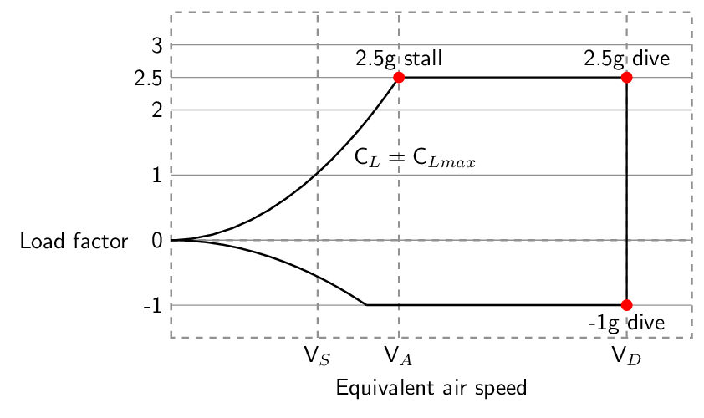
6.4.5 Maneuvering Behavior Requirements
For maneuvering, a load factor at a given speed has been supplied by the customer or airworthiness requirements.
These could be originating from a V-n Diagram.
For example:
Must be able to sustain 4.4g at 130kts
therefore
Notes:
Maneuvering important when high maneuvering requirements, what aircraft?
Fighter jets, bush planes, red bull racing, amateur planes.
4.4g means L = 4.4 * W, what’s the equation of lift anyone? Isolating CLmax

Slide 83
6.4.5 Maneuvering Behavior Requirements (Prop A/C)
For propeller aircraft, we know that:
The results from this equation can be added to the P/W-W/S diagram
Determined by your design requirements (e.g. 9G maneuverability)
y
X
Divide by W
X
Speed at which the maneuver is taking place
Notes:
The maneuver speed may be part of your intercept mission, cruise speed…
This can easily drive the design!
Although no specific example is provided here for the T/W-P/W diagram, the procedure is similar as before. You will need to be below the resulting lines (a different line for each A and Nmax).

Slide 84
6.4.5 Maneuvering Behavior Requirements (Jet A/C)
For jet aircraft, we know that:
The results from this equation can be added to the T/W-W/S diagram
Determined by your design requirements (e.g. 9G maneuverability)
y
Divide by W
X
X
Speed at which the maneuver is taking place
Notes:
The maneuver speed may be part of your intercept mission, cruise speed…
This can easily drive the design!
Although no specific example is provided here for the T/W-W/S diagram, the procedure is similar as before. You will need to be above the resulting lines (a different line for each A and Nmax).

Slide 85
Lecture Contents
Preliminary Aircraft Sizing
6.1. Introduction
6.2. Payload-Range Diagram
6.3. Rapid Sizing Method for Aircraft Weight
6.3.1 Empty Weight Estimation
6.3.2 Fuel Weight Estimation
6.3.3 Example Calculations (business jet & prop)
6.4. T/W – W/S and W/P – W/S Diagrams
6.4.1 Sizing for Stall Speed
6.4.2 Sizing for Take-off Distance
6.4.3 Sizing for Landing Distance
6.4.4 Drag Polar & Climb Behavior Requirements
6.4.5 Maneuvering Behavior Requirements
6.4.6 Design Point & Sanity Checks
Notes:
We’ve found the drag components and CD0

Slide 86
6.4.6 T/W – W/S and W/P – W/S Diagrams
Recall from the beginning of this lecture:
Choose the highest possible wing loading (W/S)
Choose the lowest possible thrust or power loading (T/W or W/P)
For jet aircraft:
For propeller aircraft:
Thrust Loading T/W
Power Loading W/P
Wing Loading W/S
Wing Loading W/S

Slide 87
6.4.6 Design Point & Sanity Checks
Choose the design point on the graph
Perhaps multiple design points are required for clean/dirty configurations
Verify that your design point satisfies all requirements
Compare your design points with reference aircraft:
Add the average of your reference aircraft, to get an idea of your average reference data
If your aircraft is far from reference aircraft, try to understand and document why
Perhaps another iteration is necessary, or you made a calculation mistake!
Note that your reference aircraft have different requirements, so it does not have to be within the feasible design region for your requirements!
Notes:
Engineering is as much as getting to right answer as it is about understanding HOW you got to an answer.

Slide 88
6.4.6 Design Point & Sanity Checks (Propeller Aircraft)
Design Region
= chosen design point
Notes:
We choose the top right option (propeller)
Adding the average aircraft
IMPORTANT NOTE: The L should be capitalized in CLMAX as this is for the whole aircraft, not the airfoil

Slide 89
6.4.6 Design Point & Sanity Checks (Propeller Aircraft)
Design Region
= chosen design point
= average of existing aircraft
Notes:
Adding the reference aircraft

Slide 90
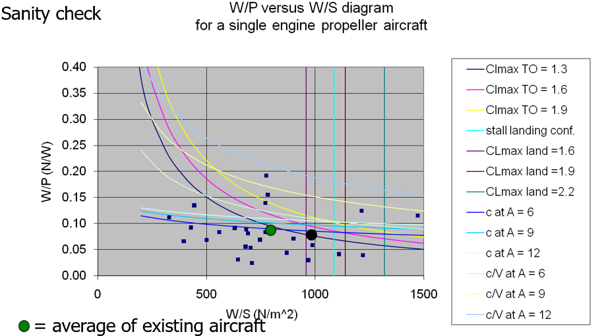
6.4.6 Design Point & Sanity Checks (Propeller Aircraft)
Notes:
IMPORTANT NOTE: The L should be capitalized in CLMAX as this is for the whole aircraft, not the airfoil

Slide 91
6.4.6 Design Point & Sanity Checks (Jet Aircraft)
Design Region
= chosen design point

Slide 92
6.4.6 Design Point & Sanity Checks (Jet Aircraft)
Design Region
= chosen design point
= average of existing aircraft

Slide 93
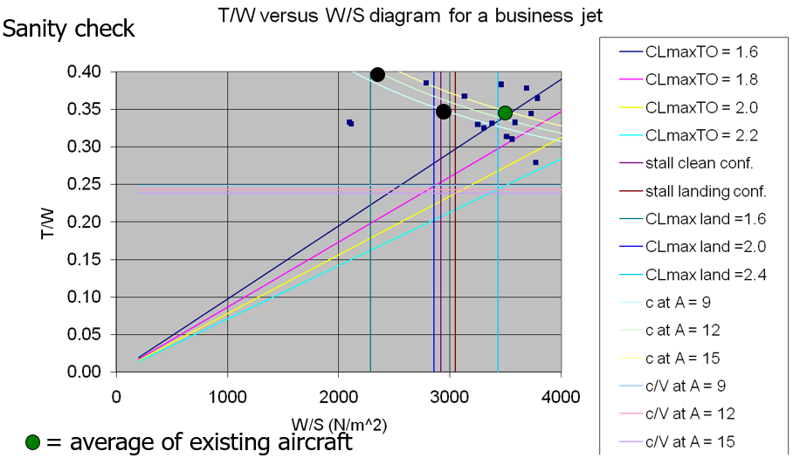
6.4.6 Design Point & Sanity Checks (Jet Aircraft)

Slide 94
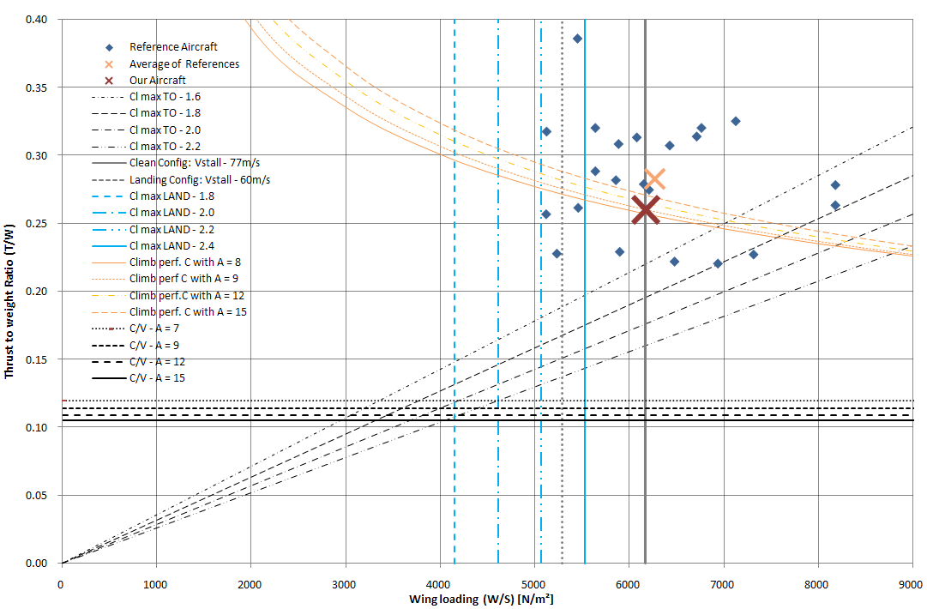
6.4.6 Design Point & Sanity Checks (Jet PAX Aircraft)
Notes:
IMPORTANT NOTE: The L should be capitalized in CLMAX as this is for the whole aircraft, not the airfoil

Slide 95
6.4 T/W – W/S and W/P – W/S Diagrams
Do not forget to perform the necessary sanity checks!
Plot your reference aircraft on the graph to see how you compare
Check whether the assumed wing loading in determining the drag polar is still OK
Use W_{TO} (MTOW) to calculate the real T_{TO}, P_{TO} and S to get a feeling for the numbers
For assignment 2:
Show relevant calculations and outcome!
If the numbers seem ridiculous there must be a mistake somewhere!
If necessary, do a design iteration and redo the design loop

Slide 96
Lecture Contents
Preliminary Aircraft Sizing
6.1. Introduction
6.2. Payload-Range Diagram
6.3. Rapid Sizing Method for Aircraft Weight
6.3.1 Empty Weight Estimation
6.3.2 Fuel Weight Estimation
6.3.3 Example Calculations (business jet & prop)
6.4. T/W – W/S and W/P – W/S Diagrams
6.4.1 Sizing for Stall Speed
6.4.2 Sizing for Take-off Distance
6.4.3 Sizing for Landing Distance
6.4.4 Drag Polar & Climb Behavior Requirements
6.4.5 Maneuvering Behavior Requirements
6.4.6 Design Point & Sanity Checks
Notes:
Contents from this slide deck is sourced and adapted from Aircraft Design 1 Course content by Dr. Joris Melkert from Delft, University of Technology

Slide 97
How to stay on track?
Complete assignment 1 (Due soon)!
Get started on your “class 1 weight estimation”

Slide 98
PRELIMINARY SIZING 2
AESP 415 – Aircraft Design Part I Basics
Lecture 8
MODULE
2
TOPIC 6
Thank You!
Dr. Wout De Backer
1000 Catawba St, Ste 120
wdbacker@cec.sc.edu

